Slide 1
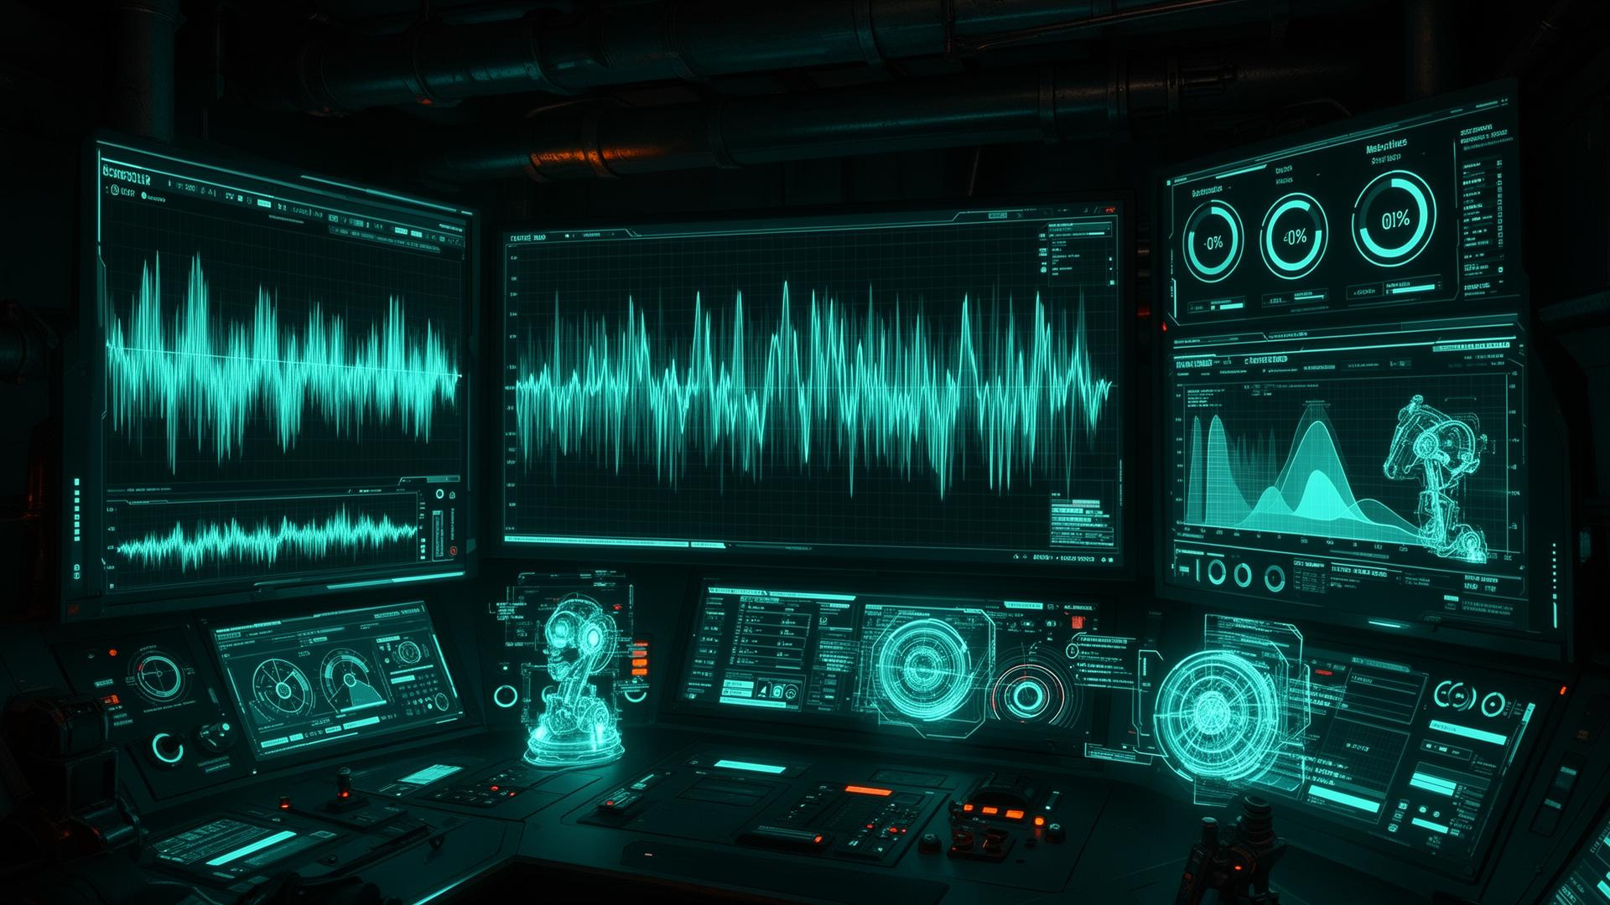
INVICTUS
PERA
SAM
Industrial Sound Analysis Manager with Acoustic AI
CO 2060 : Software Systems Design Project
Team : Invictus | Team 29

Slide 2


INVICTUS
WHY
SAM ?
PROBLEM:
Machines such as laptop/PC cooling fans, vehicle engines, pumps, and industrial assets often fail without early warning. Traditional maintenance is usually reactive (repair after failure), which can cause overheating, downtime, and higher repair cost.
TARGET USERS:
Laptop/PC users
IT technicians (data center / office PC maintenance)
Maintenance technicians (industrial machines)
Fleet/asset managers (vehicles, factories)
Sound engineers.

Slide 3
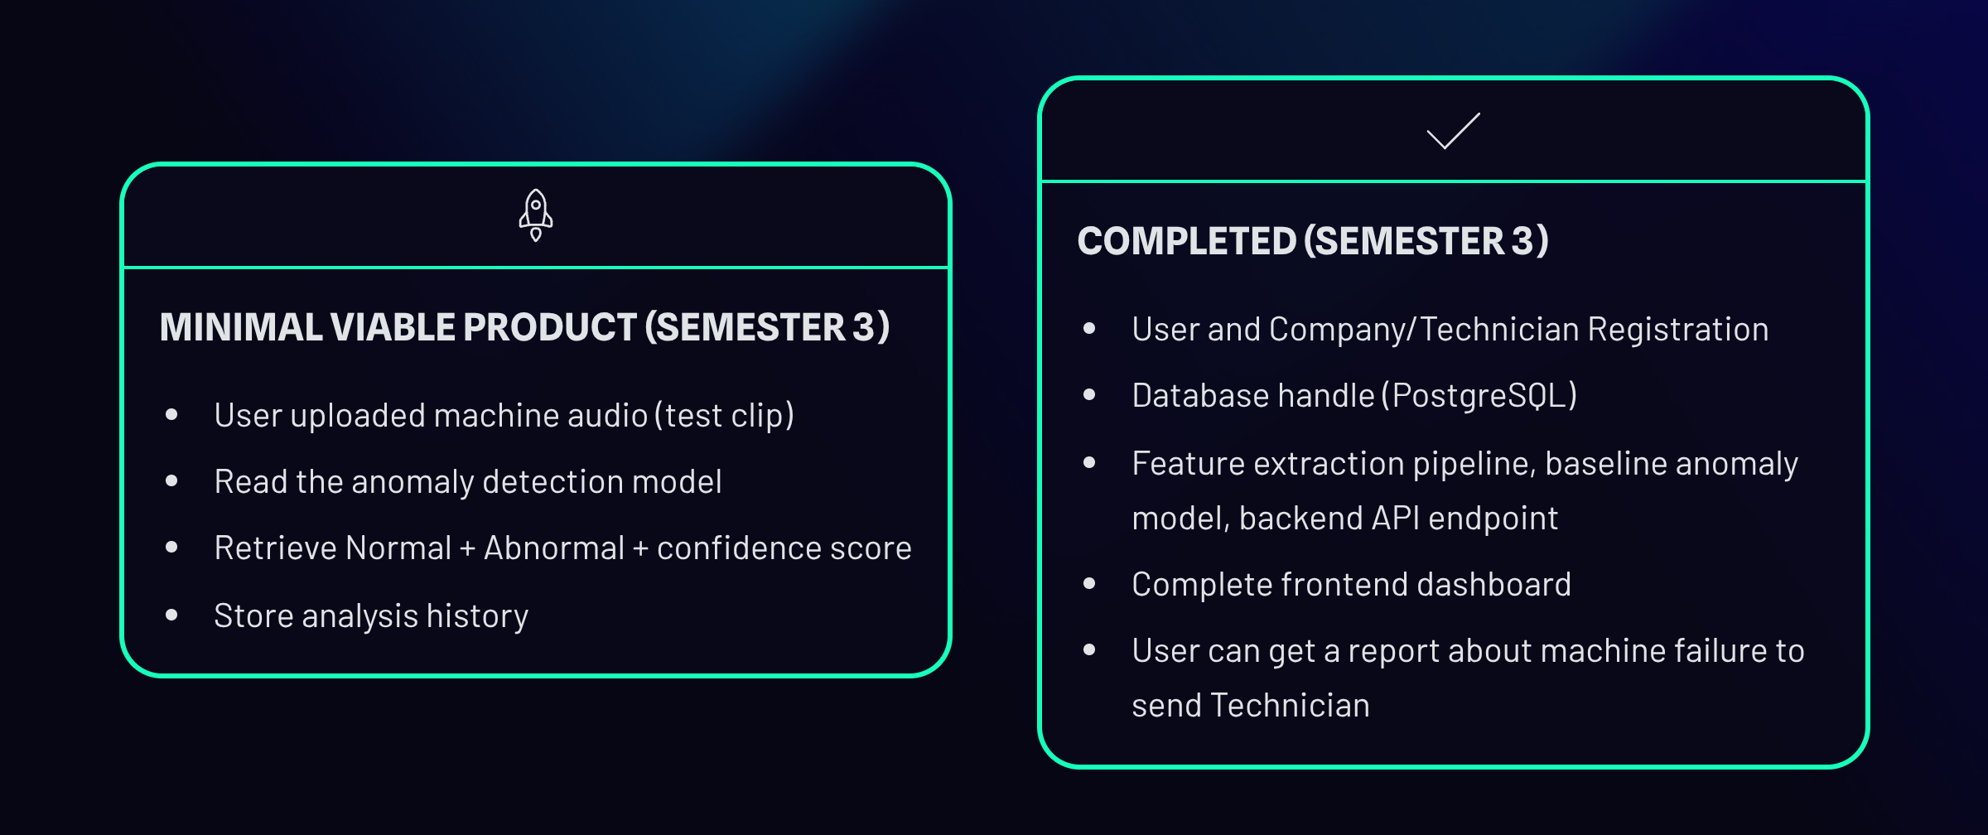
INVICTUS
PROGRESS
WHAT WE COMPLETED

Slide 4
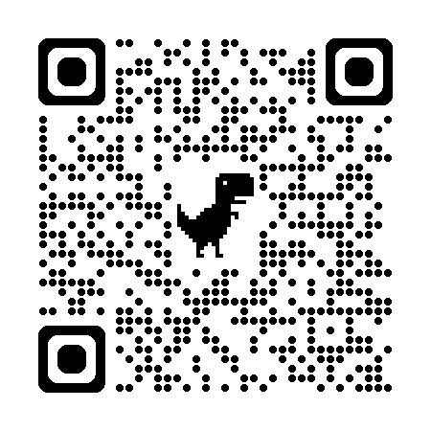
INVICTUS
MVP LIVE
DEMO
System Live
Click URL: PERA-SAM | Acoustic Intelligence

Slide 5
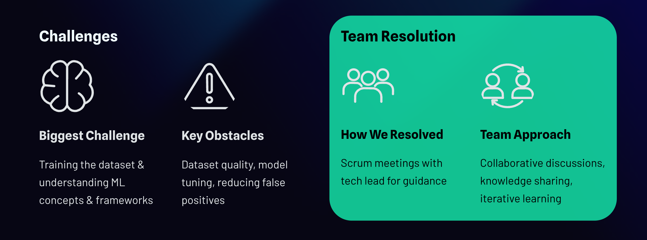
INVICTUS
CHALLENGES
& RESOLUTIONS

Slide 6

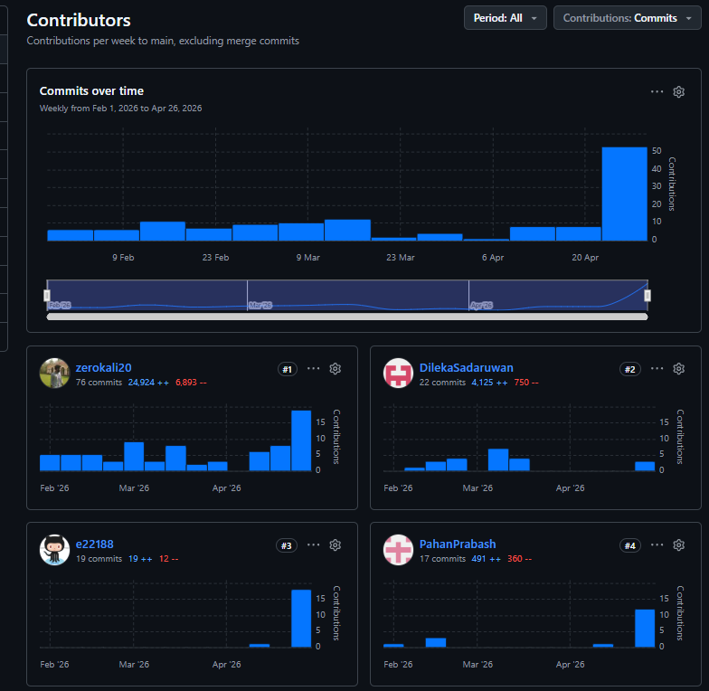
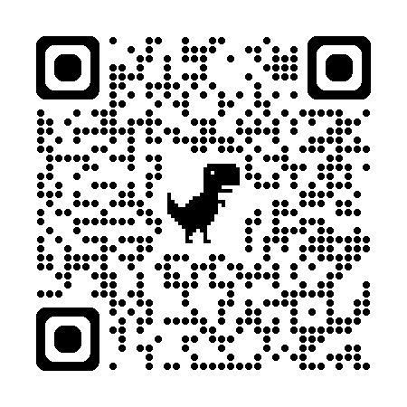
INVICTUS
TEAM
COLLABORATION
Front-end design (React +Vite, TypeScript, Tailwind CSS, Radix UI.)
React + Ts codebase implement & maintain.
Back-end integration works.
Docker deploy & cloud hosting. (Azure)
E/22/396
E/22/184
Database monitoring (Supabase (PostgreSQL).)
Data set handling & model training. Front end Landing page & Map navigation.
Back-end authentication work.
End point API testing using postman.
E/22/336
Front-end Sound upload page implement.
Back-end integration. (Python, FastAPI, Uvicorn.)
Back-end workflow monitoring.
Test cases & unit testing.
(Leader)
E/22/188
Front-end Dashboard integration.
Navigation panel rebuild (Landing Page).
Maintain Product back log and SRS document.
Project report & documentation handling.
Our GitHub Repo:

Slide 7
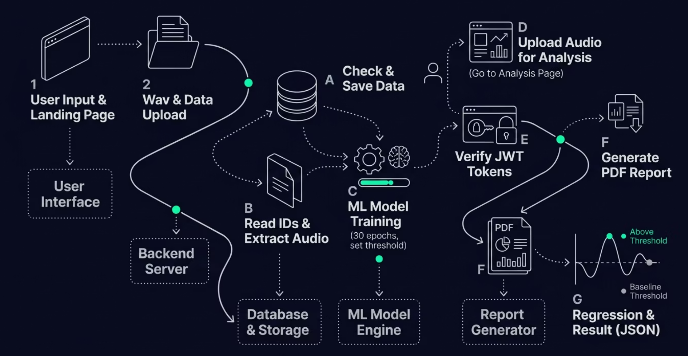
MVP SYSTEM
INVICTUS
WORKFLOW

Slide 8
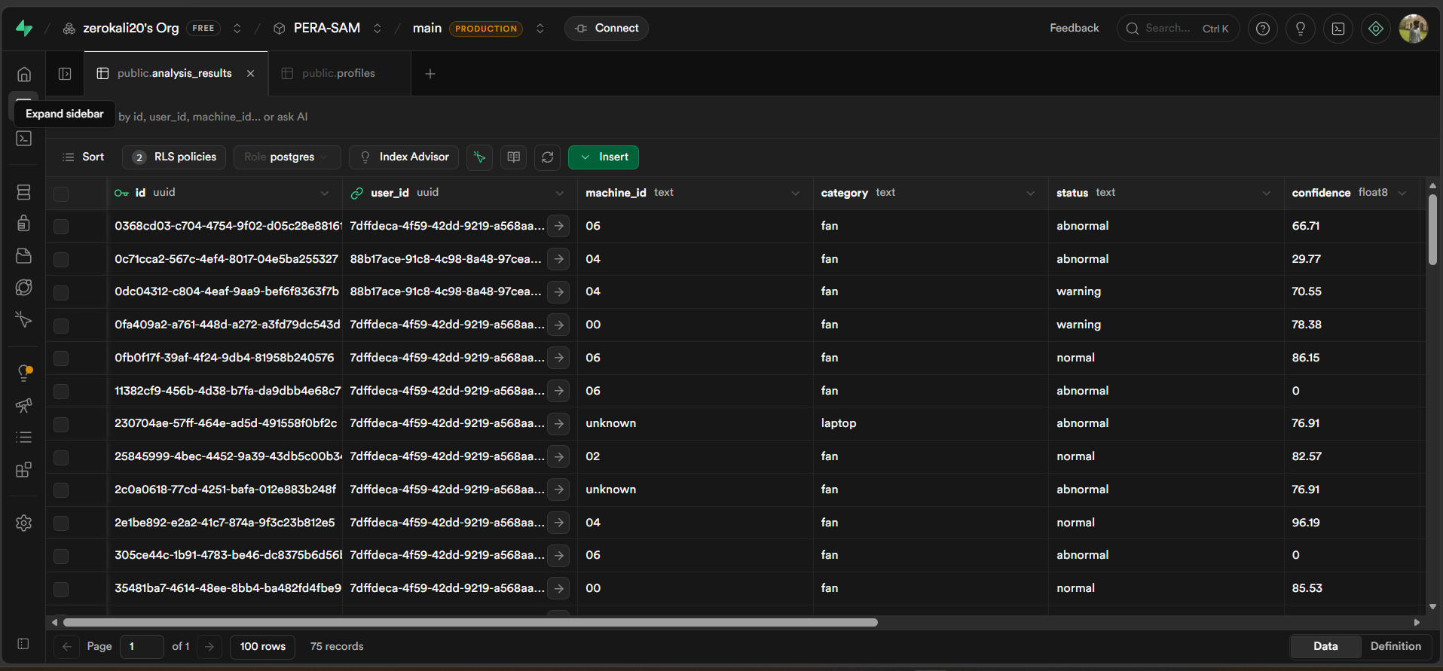
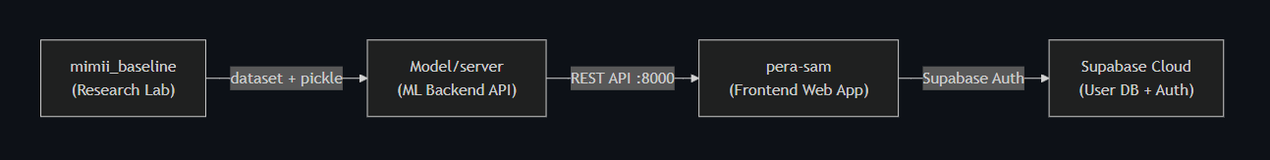
INVICTUS
WORK WITH
PERA-SAM
System Live
Live analysis in supabase
SAM
Architecture

Slide 9
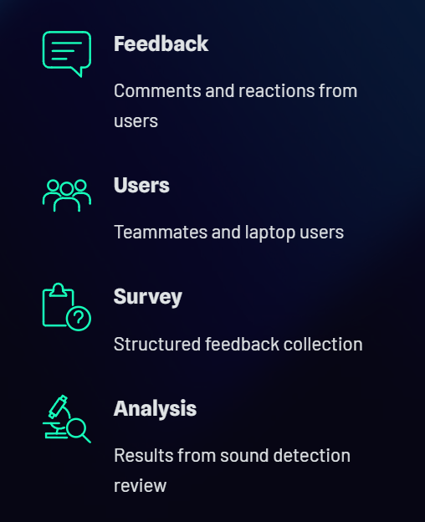
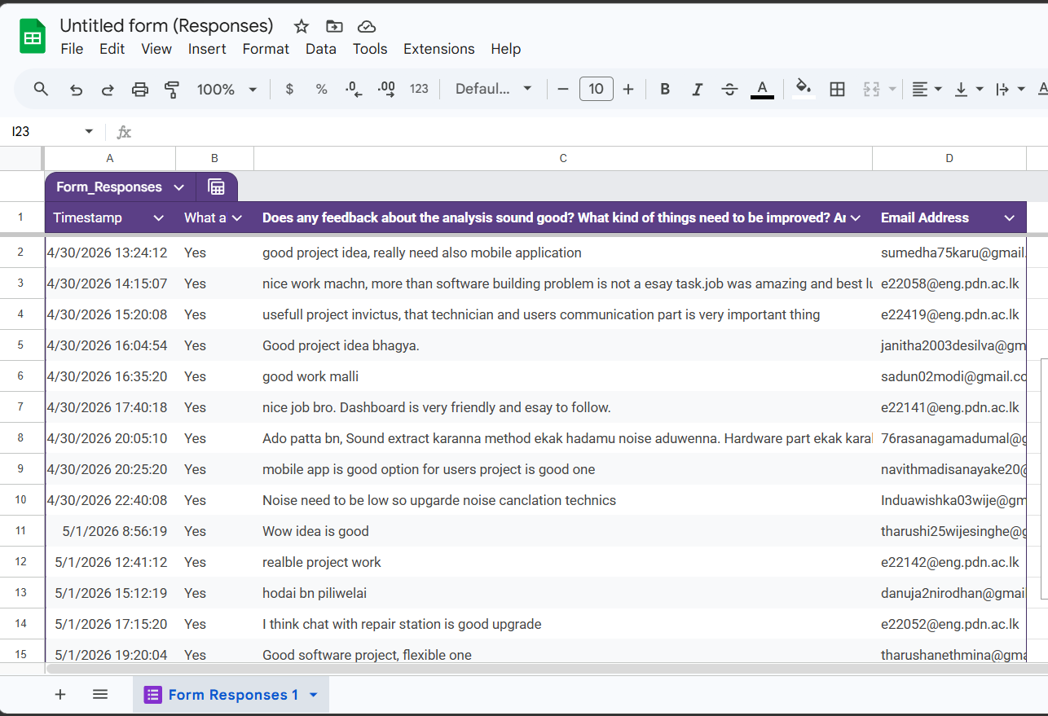
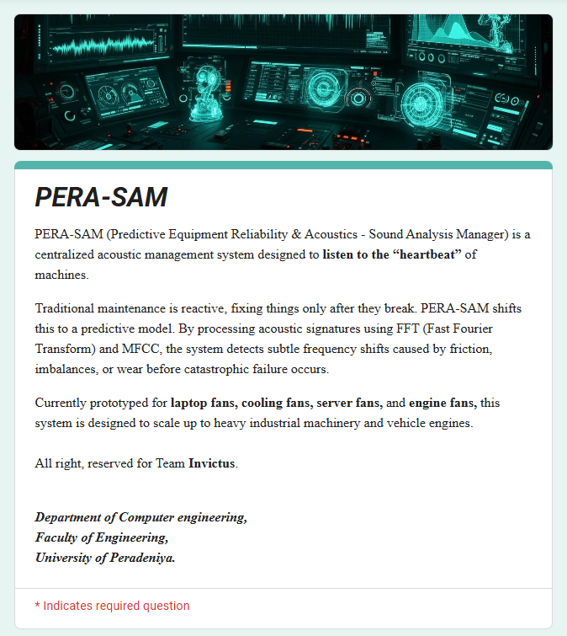
INVICTUS
CUSTOM
FEEDBACK
Present feedback from the real users.
Most of them result some time failure with background noise, So most of feedback is it.

Slide 10
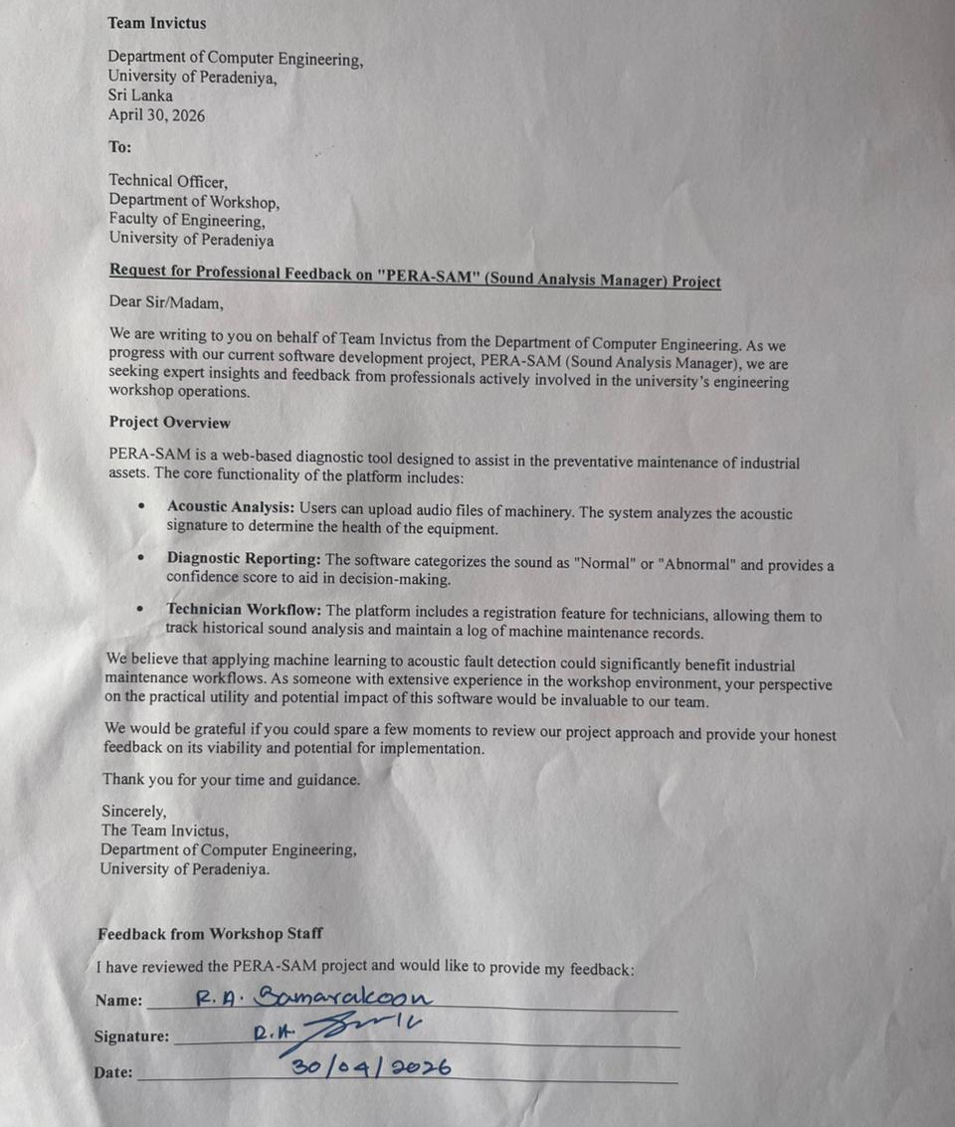
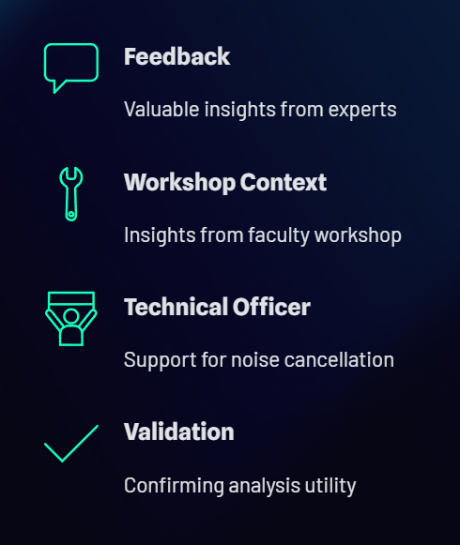
INVICTUS
CUSTOM
FEEDBACK
Feedback from Faculty Engineering Work Department.
They give a valuable feedback from workshop technical officer in charge.
He suggest for develop to cancel background noise also !

Slide 11
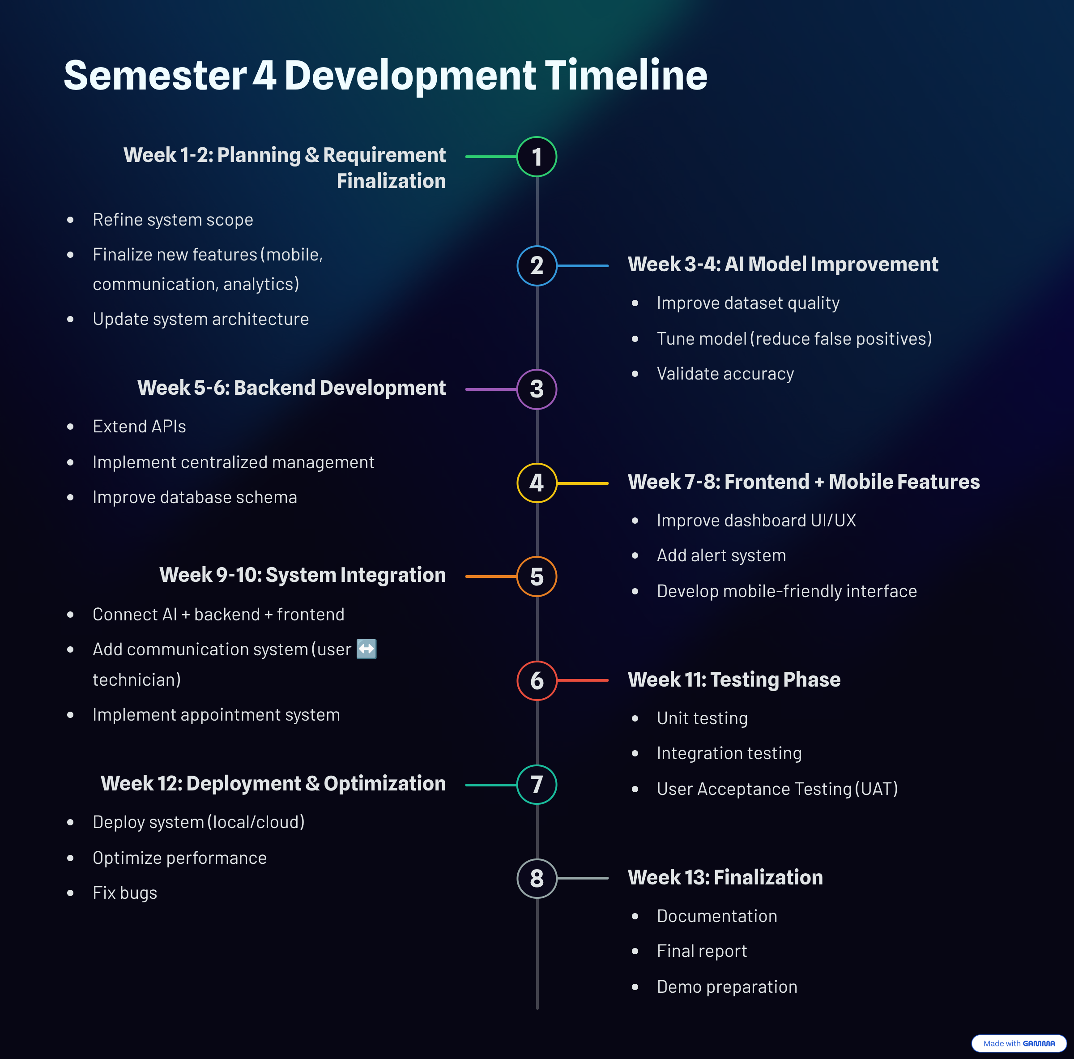
INVICTUS
WHAT OUR
NEXT PLAN
(SEMESTER 4)
Integrate water pipeline model.
Enhanced communications.
Improved user appointments.
Mobile application.
Documentation management.
Testing & product finalize.

Slide 12

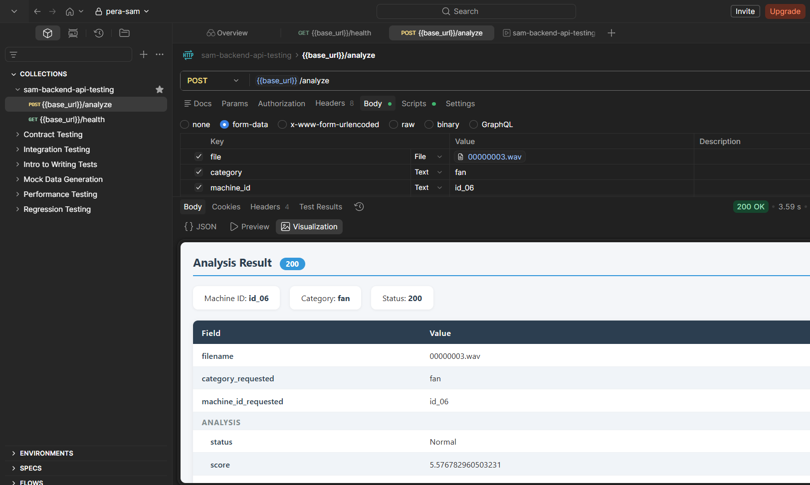
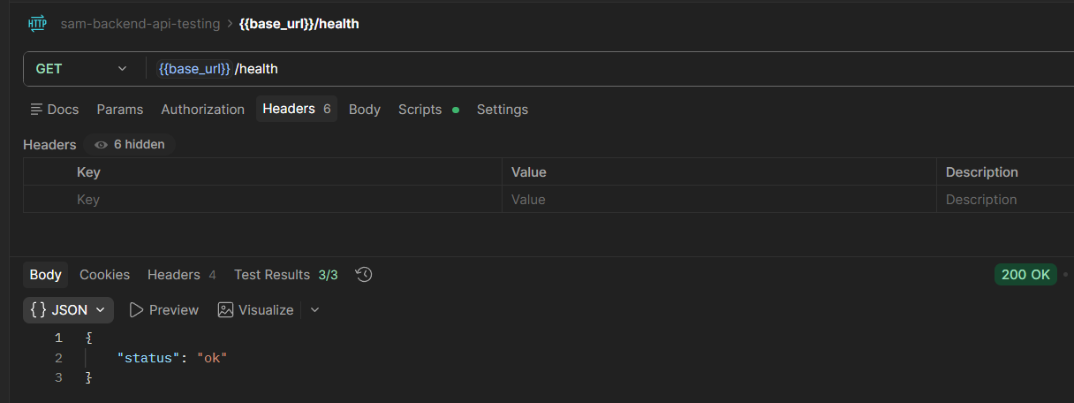
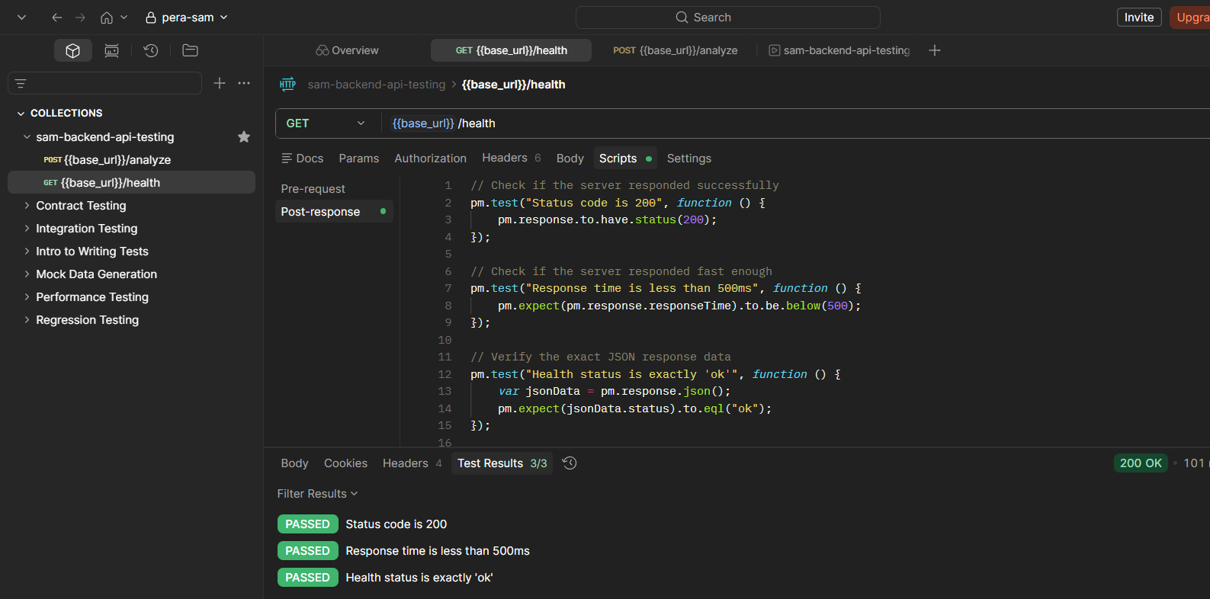
INVICTUS
TESTING
STRATEGY
API Endpoints Unit Testing (Postman)
/analyze Endpoint
backend Api testing
/health Endpoint

Slide 13
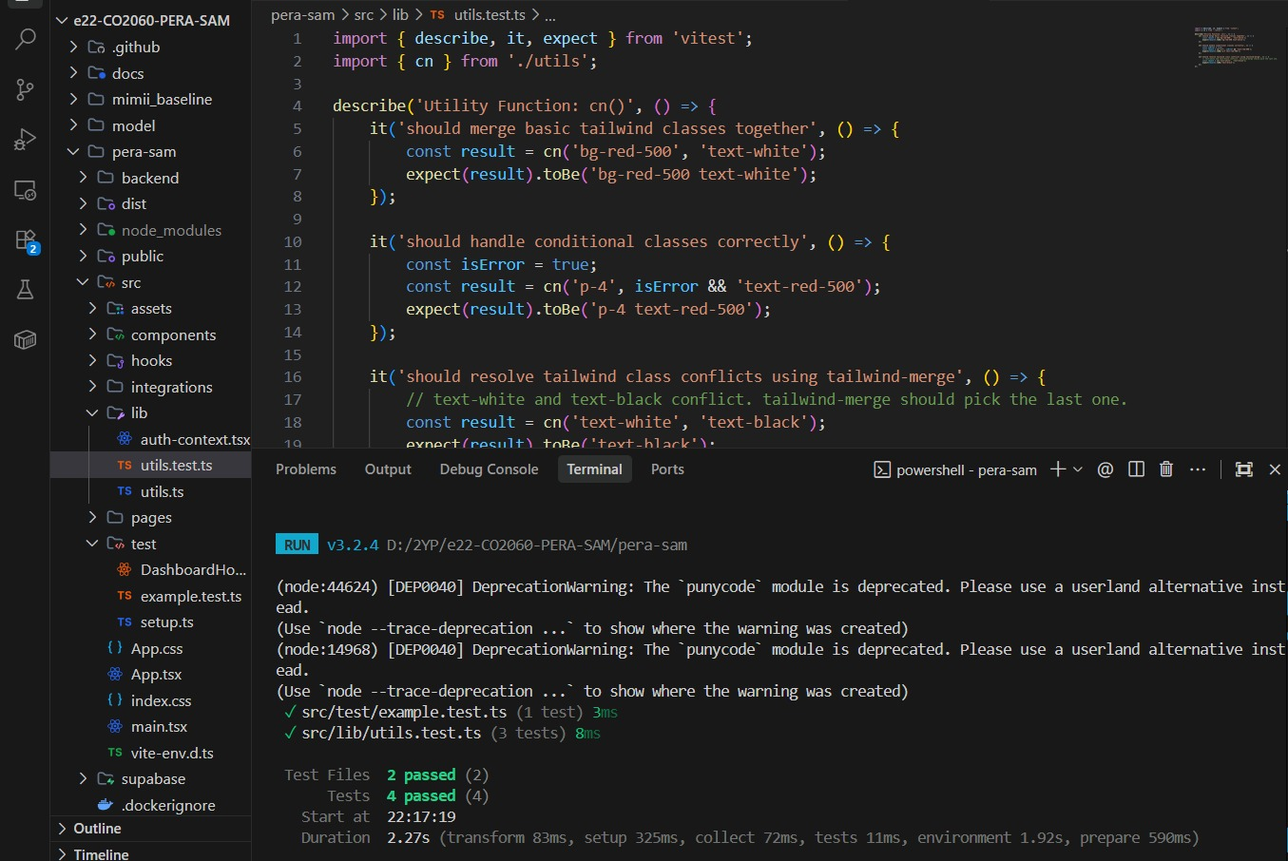
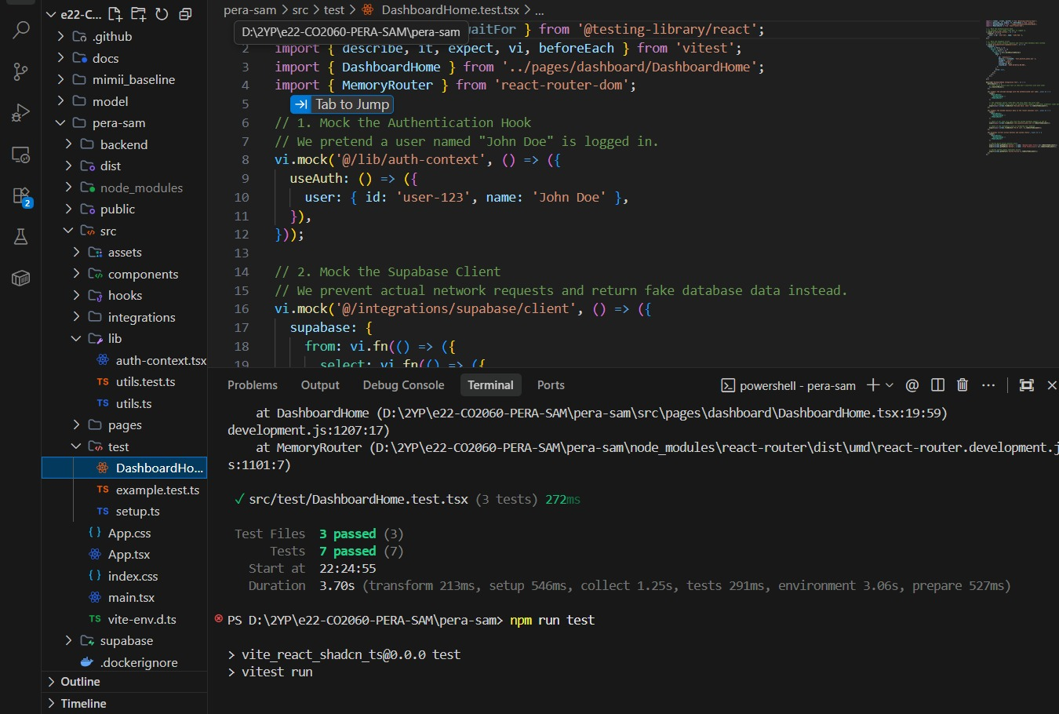
INVICTUS
Frontend Unit Testing using Vitest
Unit testing example.test.ts & utils.test.ts testing
dashboard unit testing

Slide 14

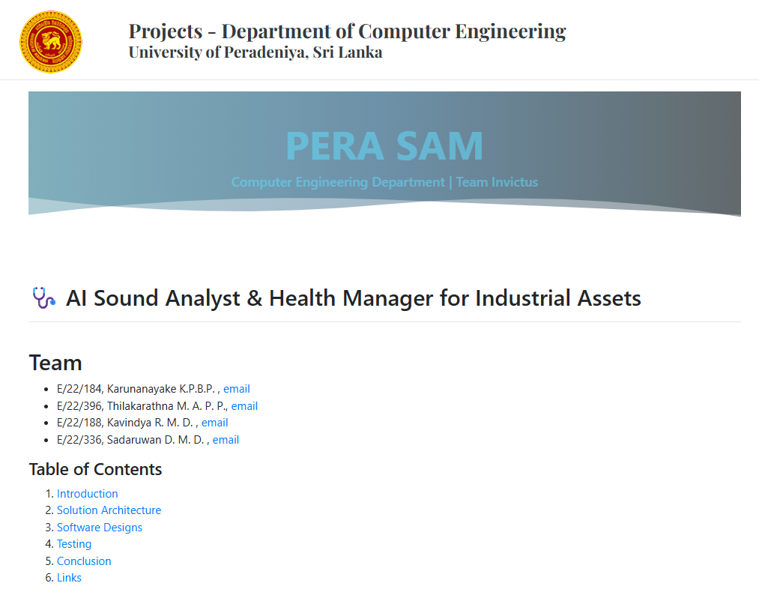

INVICTUS
DEPLOYMENT
& DOCUMENTATION
Visit Us
Click to GitHub Repo:
https://github.com/cepdnaclk/e22-co2060-PERA-SAM
Visit Our Project Page:
https://https://cepdnaclk.github.io/e22-co2060-PERA-SAM

Slide 15



Dileka
sandaruwan
Dhanushka
kavindaya
CN Portfolio
CN Portfolio
E/22/336
E/22/188
Pahan
prabash
CN Portfolio
E/22/396
Bhagya
karunanayake
CN Portfolio
E/22/184
PERA-SAM

